Slide 1





Mai Xuân Tráng, PhD
Khoa Công Nghệ Thông Tin Trường Đại học Phenikaa Email: trang.maixuan@phenikaa-uni.edu.vn
SDT: 0965590406
1

Slide 2
Today
Requirements
What are requirements?
How can we gather requirements?
A first example.
Common challenges and mistakes.

Slide 3
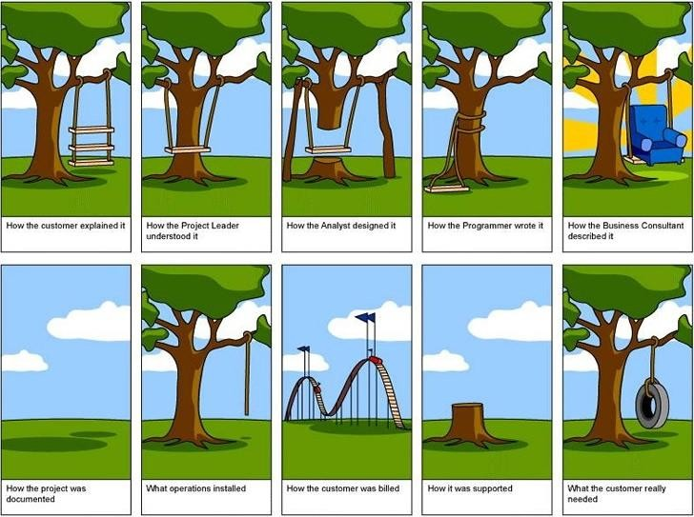
Requirements in one picture

Slide 4
Software requirements
Requirements specify what to build
describe what, not how
describe the problem, not the solution
reflect system design, not software design

Slide 5
“What” vs. “how” is relative
One person’s what is another person’s how:
Input file processing is the what, parsing is the how.
Parsing is the what, a stack is the how.
Stack is the what, a linked list is the how.
A linked list is the what, Node* is the how.

Slide 6
Why should you care and focus on requirements?
Benefits of eliciting requirements from customers:
The #1 reason that projects succeed is user involvement [Standish Group survey of over 8000 projects].
Easy access to end users is one of three critical success factors in rapid-development (agile) projects [Steve McConnell].
Benefits of working with customers:
Good relations improve development speed.
Improves perceived development speed.
Customers don’t always know what they want.
Customers do know what they want...it just changes over time.

Slide 7
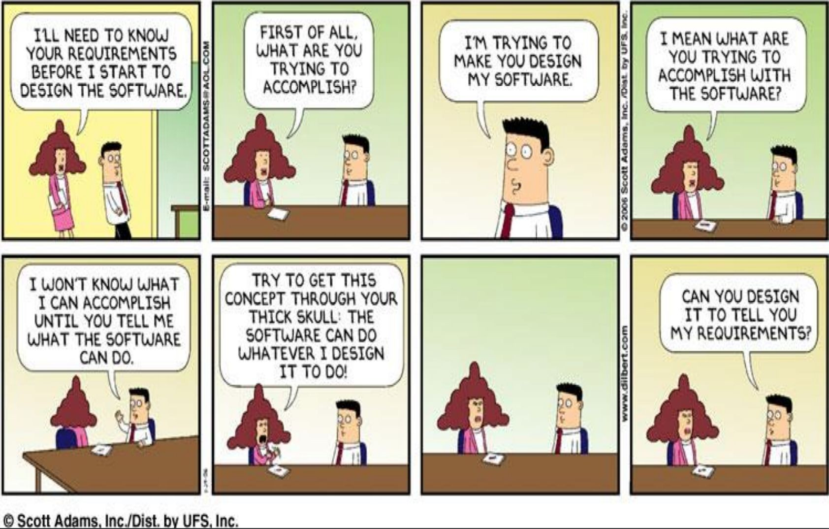
How to elicit requirements?

Slide 8
Requirements: Goals and roles
Goals when eliciting requirements:
Understand precisely what is required of the software.
Communicate this understanding precisely to all involved parties.
Control production to ensure that system meets specification.
Roles of requirements:
Customers: what should be delivered (contractual base).
Managers: scheduling and monitoring (progress indicator).
Designers: a spec to design the system.
Coders: a range of acceptable implementations.
QA / Testers: a basis for testing, verification, and validation.

Slide 9
How to elicit requirements?
Do:
Talk to the users -- to learn how they work.
Ask questions throughout the process -- "dig" for requirements.
Think about why users do something in your app, not just what.
Allow (and expect) requirements to change later.
Don't:
Be too specific or detailed.
Describe complex business logic or rules of the system.
Describe the exact user interface used to implement a feature.
Try to think of everything ahead of time. (You will fail!)
Add unnecessary features not wanted by the customers.

Slide 10
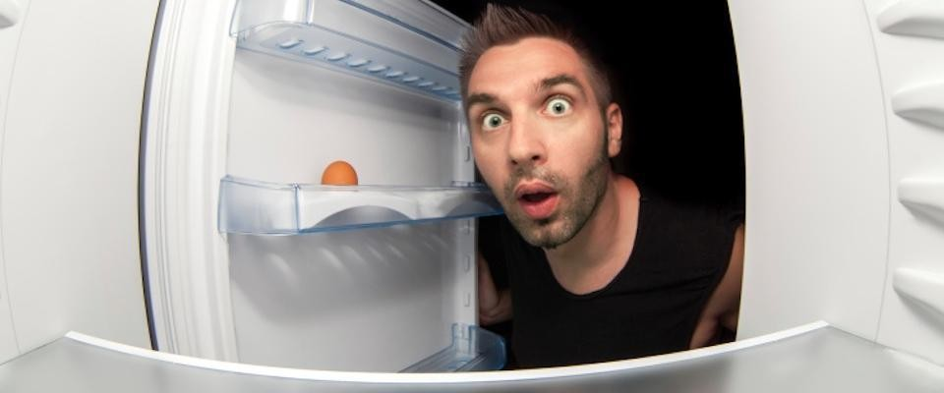
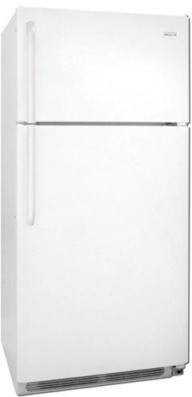
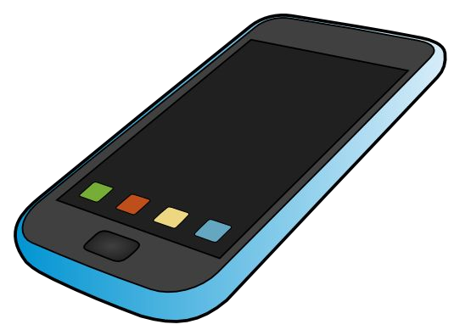

Example project: smart fridge
Scenario (when this crisis is over):
Dinner/party time.
On the way home.
Inviting a lot of friends.
Is the fridge stocked?
Solution:
DIY smart fridge.
Realtime data.
Mobile app.

Slide 11
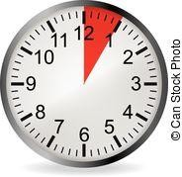
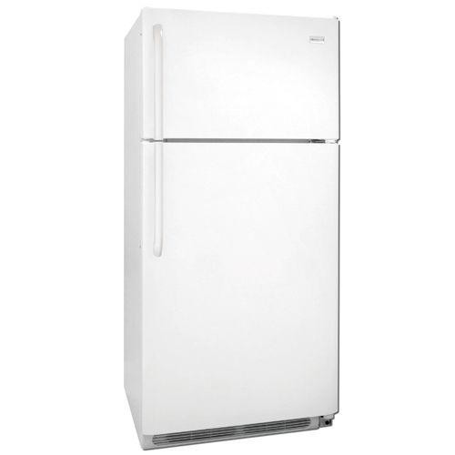
Smart fridge requirements
Solution:
DIY smart fridge.
Realtime data.
Mobile app.
Breakout rooms:
Two teams, 3x5 minutes
Team 1: customer; team 2: developer
Team 2: customer; team 1: developer
Group requirements
Instructions:
https://docs.google.com/document/d/12CTMEWtMGy7H5S0XK35NTF5risIJ1x6M_LdW1UeQ02w

Slide 12
Requirements engineering
The process of eliciting, analyzing, documenting, and maintaining requirements.
Classic way to classify requirements:
Functional requirements
E.g., input-output behavior
Non-functional requirements
E.g., security, privacy, scalability
Additional constraints
E.g., programming language, frameworks, testing infrastructure

Slide 13
Challenges and mistakes
Common Challenges
Unclear scope and unclear requirements.
Changing/evolving requirements.
Finding the right balance (depends on customer):
Comprehensible vs. detailed.
Graphics vs. tables and explicit and precise wording.
Short and timely vs. complete and late.
Common Mistakes
Implementation details instead of requirements.
Feature creep/bloat.

Slide 14
Feature creep/bloat
Feature creep:
Gradual accumulation of features over time.
Often has a negative overall effect on a large software project.
Why does feature creep happen? Because features are fun!
Developers like to code them.
Sales teams like to brag about them.
Users (think they) want them.
Why is it bad?
Too many options, more bugs, more delays, less testing, …
"Boiled frog" analogy.
Can you think of any products that have had feature creep?

